Slide 1
MotoGP Database
Team 29 - ETL Project

Slide 2
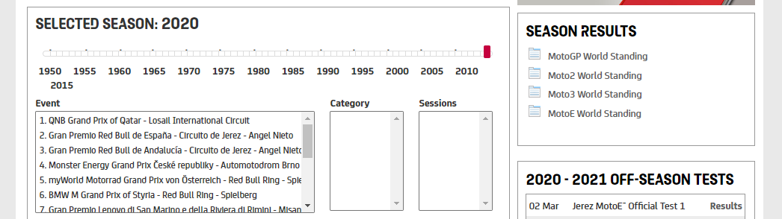
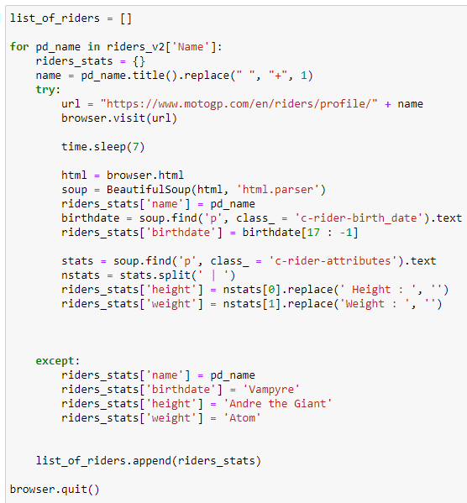
Extract
Sourced data by scraping data several databases into list of dictionaries
Rider Profiles
Name, birthdate, height, weight
Weather
Track, date, league, event type, track condition, humidity, track, air temp
Lap times for all testing, practices, qualifying, warm ups, and races including:
Date, league, session type, track, rider number, finishing position
Total laps run, tires used, laps on the tires
Implemented time.sleep function to resolve issue where data wouldn’t be scraped due to website load time
Implemented Selenium to reach sections of site unreachable by manipulating the url
Implemented listdir, mkdir to track files that have already been processed and prevent scraping and parsing the same files multiple times while allowing for the script to be run after each race and ensure that the file trees are as expected
Investigated using other databases (wikipedia, etc), but motoGP provided most complete dataset

Slide 3
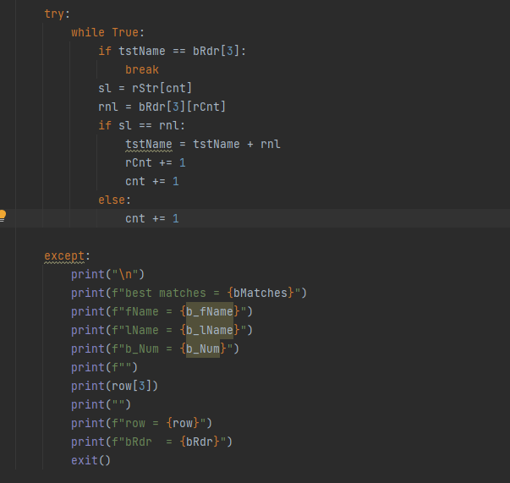
Transform
Cleaned data using Pandas in Jupyter Notebook
Imported csv files into dataframes
Removed duplicates and null values
Saved to csv
Parsed .pdf files in PyCharm
Implemented pdfplumber, fnmatch and regex to parse pdf files

Slide 4
Load
Utilized PGAdmin to load data into final relational database
Created tables complete with primary and foreign keys for future analysis
Future analysis topics could include:
Which countries produce the most winners?
Do some countries perform better in poor weather conditions?
When are riders in their racing prime?

Slide 5
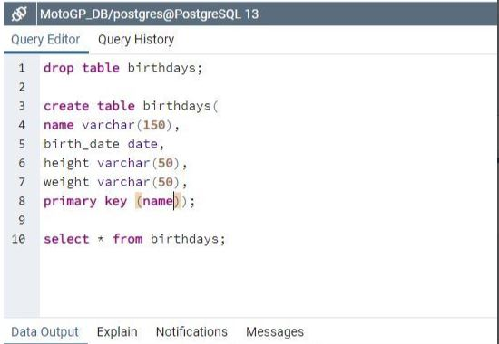
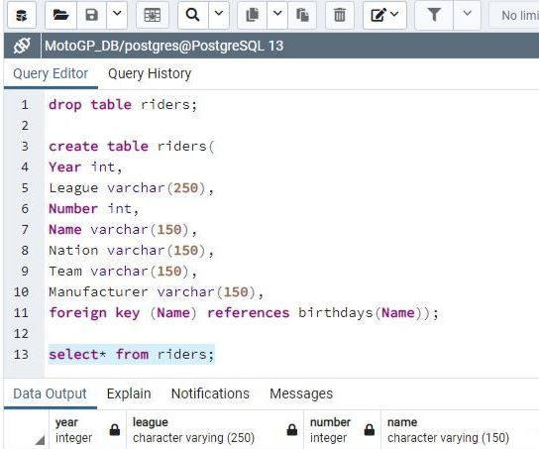
Schemas

Slide 6
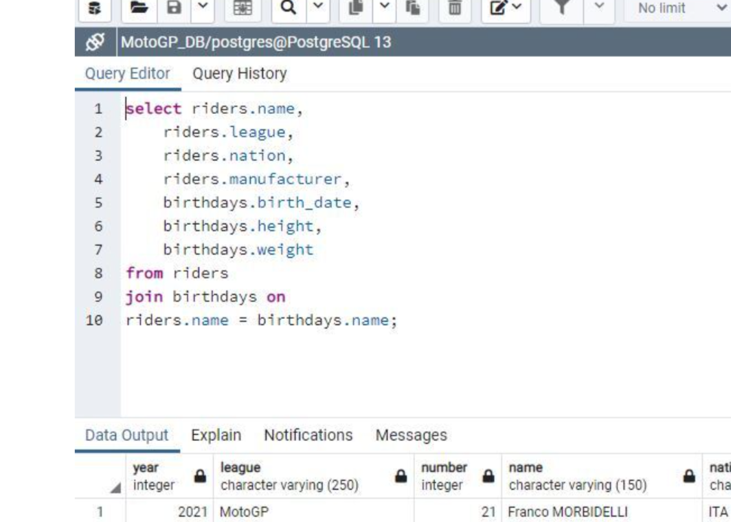
Join

Slide 7
Sources
Sources:
motogp.com/en/riders/profile/{first_name}+{last_name}
motogp.com/en/Results+Statistics/{year}/{country}/{league}
motogp.com/en/Results+Statistics/{year}/{country}/{league}/{session}/Classification

